Slide 1
CSCI2100E Tree

Slide 2

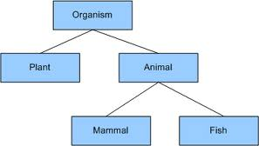
Trees

Slide 3
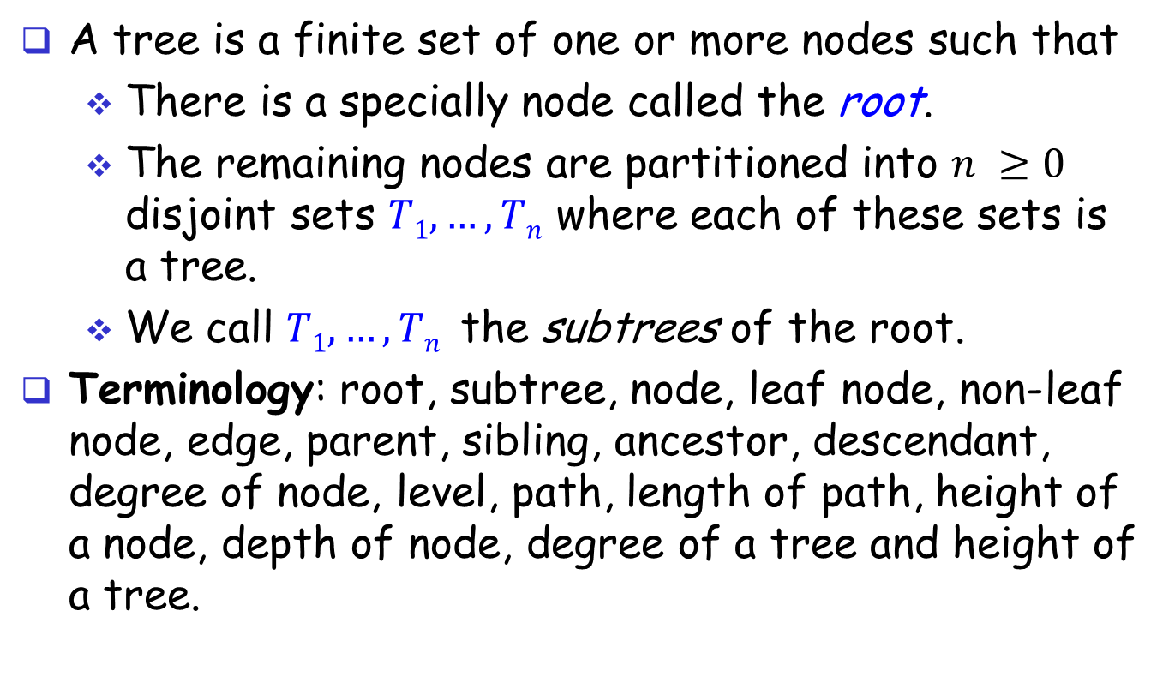
Trees
A tree is a finite set of one or more nodes such that
There is a specially node called the root.
The remaining nodes are partitioned into $n ≥0$ disjoint sets $T1, …, Tn$ where each of these sets is a tree.
We call $T1, …, Tn$ the subtrees of the root.
Terminology: root, subtree, node, leaf node, non-leaf node, edge, parent, sibling, ancestor, descendant, degree of node, level, path, length of path, height of a node, depth of node, degree of a tree and height of a tree.

Slide 4
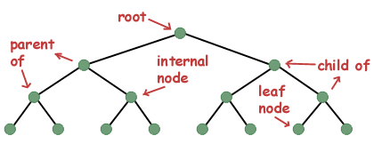
Trees (cont’d)
A
root
path
subtree
B
C
D
E
F
G
H
I
J
K
L
M
Terminology: root, subtree, node, leaf node, non-leaf node, edge, parent, sibling, ancestor, descendant, path, length of path, ...

Slide 5
Degree of Node and Degree of Tree
The degree of a node is the number of subtrees of the node.
The degree of a tree is the maximum degree of the nodes in the tree.
Node degree
A 3
B 2
C 1
D 3
...
M 0
Degree of tree = 3
level 1:
A
level 2:
B
C
D
level 3:
E
F
G
H
I
J
level 4:
K
L
M

Slide 6
Height and Depth
In some books
The height of a node is the number of edges in the longest path from the node to a leaf.
The depth of a node is the number of edges in the path from the root to the node.
The height of the tree is the height of its root.
In this book:
The height or depth of a tree is the maximum level of node in the tree.
level 1:
A
level 2:
B
C
D
level 3:
E
F
G
H
I
J
level 4:
K
L
M

Slide 7
# of Nodes and # of Edges
Number of nodes = number of edges + 1
Proof: Every node (except the root) has an edge leading to it. Then, the number of edges = the number of nodes – 1. Hence, number of nodes = number of edges + 1.
A
B
C
D
E
F
G
H
I
J
K
L
M

Slide 8
Tree Representation
A tree is different from a linked list.
A linked list is a linear data structure.
A tree is a non-linear data structure.
data
link 1
link 2
...
link n
data
link 1
link 2
...
link n
data
link 1
link 2
...
link n
data
link 1
link 2
...
link n

Slide 9
Binary Trees (a special tree)
A binary tree is a finite set of nodes that is either empty or consists of a root and two disjoint binary trees called the left subtree and the right subtree.
Skewed binary tree
a binary tree such that all the nodes except one have one and only one child.
2 different binary trees:
A
C
B
D
A
B
D
A
E
F
H
I
B
K
L
E
skewed tree
K

Slide 10
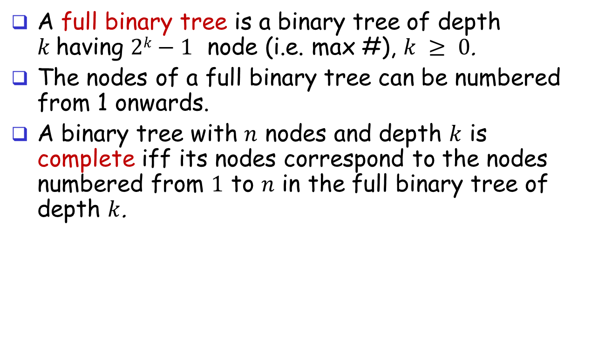
Full Binary Tree / Complete Binary Tree
A full binary tree is a binary tree of depth $k$having $2k−1$ node (i.e. max #), $k ≥ 0$.
The nodes of a full binary tree can be numbered from 1 onwards.
A binary tree with $n$ nodes and depth $k$ is complete iff its nodes correspond to the nodes numbered from $1$ to $n$ in the full binary tree of depth $k$.
A
1
A
B
D
2
3
B
D
E
F
H
I
4
5
6
7
E
F
H
I
K
L
8
9
10
11
12
13
14
15
K
L
not a complete
binary tree
full binary tree
complete binary tree

Slide 11
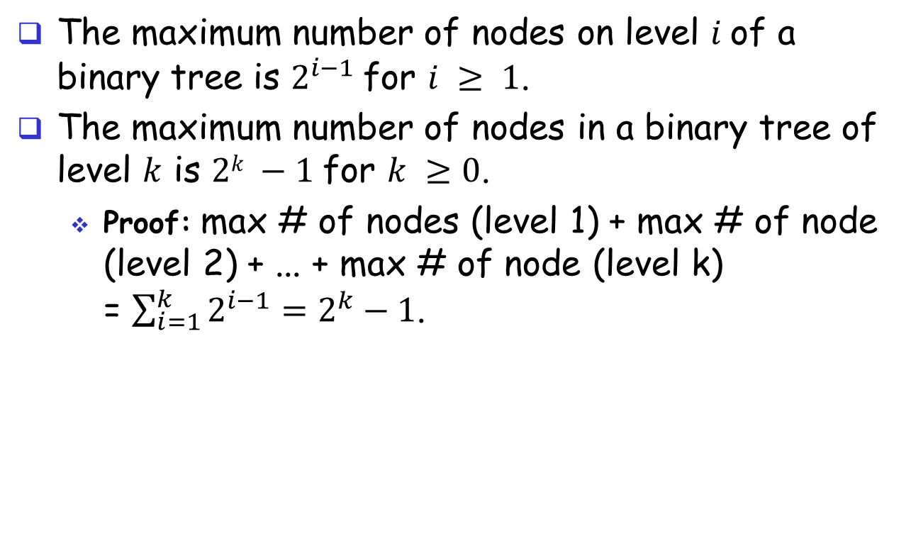
Nodes in Binary Trees
The maximum number of nodes on level $i$of a binary tree is $2^{i−1}$for $i ≥ 1$.
The maximum number of nodes in a binary tree of level $k$ is $2k −1$for $k ≥0$.
Proof: max # of nodes (level 1) + max # of node (level 2) + ... + max # of node (level k) = $\sum_{i=1}^{k}{2^{i−1}}=2^{k}−1$.
A
B
D
E
F
H
I
K
L

Slide 12
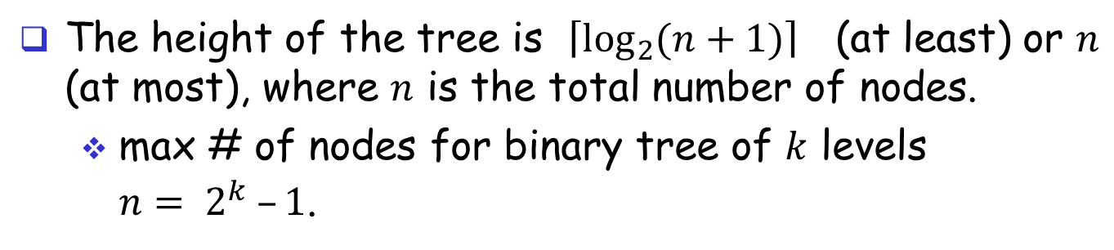
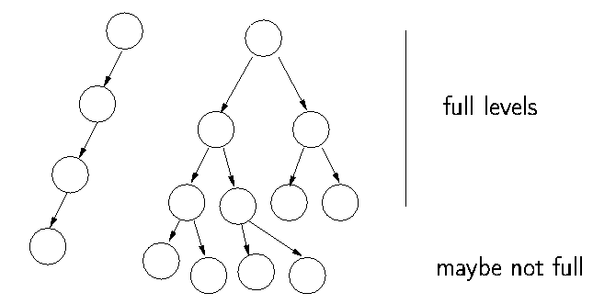
The height of the tree is $\left\lceil \log_{2}{(n+1)}\right\rceil$ (at least) or $n$ (at most), where $n$ is the total number of nodes.
max # of nodes for binary tree of $k$ levels ${n= 2}^{k} –1$.

Slide 13
Binary Tree ADT
Objects: a finite set of nodes either empty or consisting of a root node, left Binary_Tree, and right Binary_Tree.
Functions/Operators:
BinTree Create(): creates an empty binary tree
Boolean IsEmpty(bt): if (bt==empty binary tree) return TRUE else FALSE
BinTree MakeBT(bt1,item,bt2): return a binary tree whose left subtree is bt1 and right subtree is bt2, and whose root node contains the data item
BinTree Lchild(bt) : if (bt==empty binary tree) return error else return the left subtree of bt
BinTree Rchild(bt): if (bt==empty binary tree) return error else return the right subtree of bt
Element Data(bt): if (bt==empty binary tree) return error else return the data in the root node of bt.

Slide 14
Binary Tree Representation (1)
Use pointers.
A
typedef struct _node {
char data;
struct _node *left_child, *right_child;
} node;
B
D
E
H
I
K
L
A
B
NULL
D
E
NULL
H
NULL
NULL
I
NULL
NULL
K
NULL
NULL
L
NULL

Slide 15
Binary Tree Representation (2)
An Array Representation
1 A
2 B
3 D
4 E
5
6 H
7 I
8 K
9 L
10
11
12
13
14
15
1
A
2
3
B
D
4
5
6
7
E
H
I
8
9
10
11
12
13
14
15
K
L
full binary tree

Slide 16
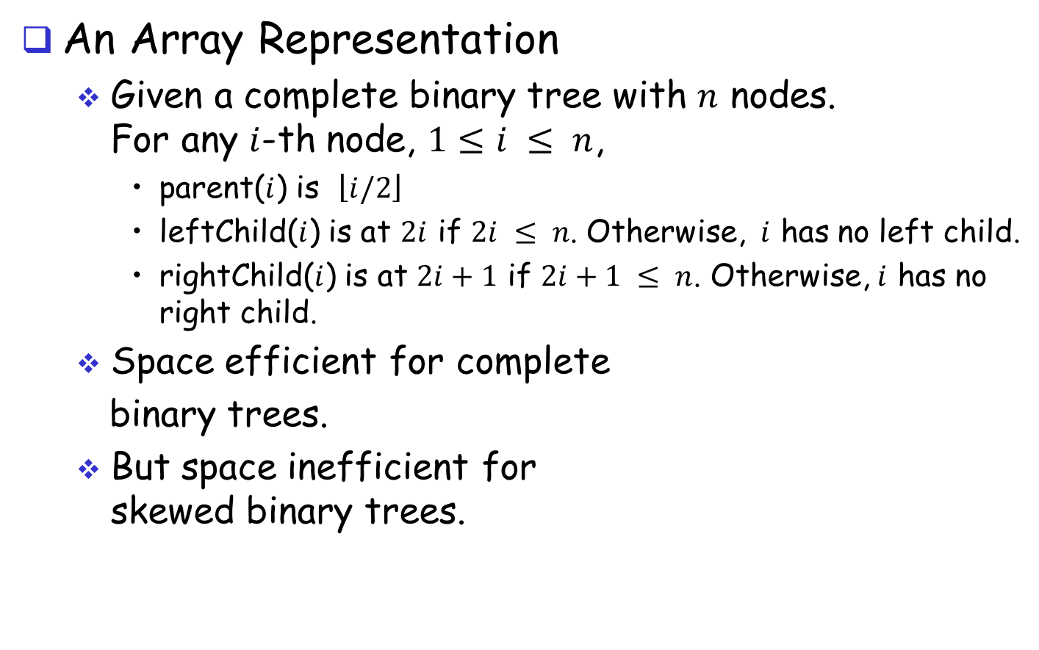
Binary Tree Representations (3)
An Array Representation
Given a complete binary tree with $n$ nodes. For any $i$-th node, $1≤i ≤ n$,
parent($i$) is $\left\lfloor i/2\right\rfloor$
leftChild($i$) is at $2i$ if $2i ≤ n$. Otherwise, $i$ has no left child.
rightChild($i$) is at $2i+1$ if $2i+1 ≤ n$. Otherwise, $i$ has no right child.
Space efficient for complete
binary trees.
But space inefficient for skewed binary trees.
1
2
3
4
5
6
7
8
9
10
11
12
13
14
15

Slide 17
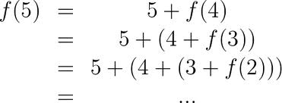
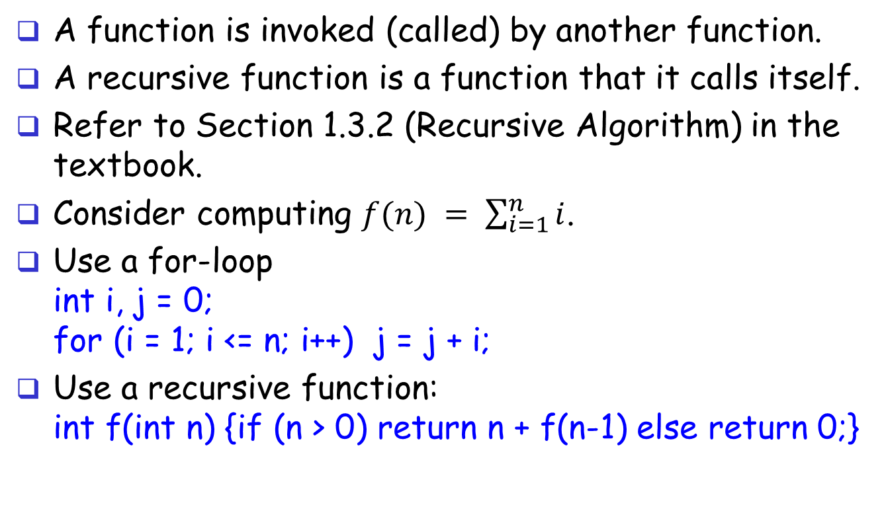
Recursion
A function is invoked (called) by another function.
A recursive function is a function that it calls itself.
Refer to Section 1.3.2 (Recursive Algorithm) in the textbook.
Consider computing $f(n) = \sum_{i=1}^{n}{i}$.
Use a for-loop int i, j = 0; for (i = 1; i <= n; i++) j = j + i;
Use a recursive function: int f(int n) {if (n > 0) return n + f(n-1) else return 0;}

Slide 18


Recursion
Drawing Hands (M.C. Escher, 1948)

Slide 19
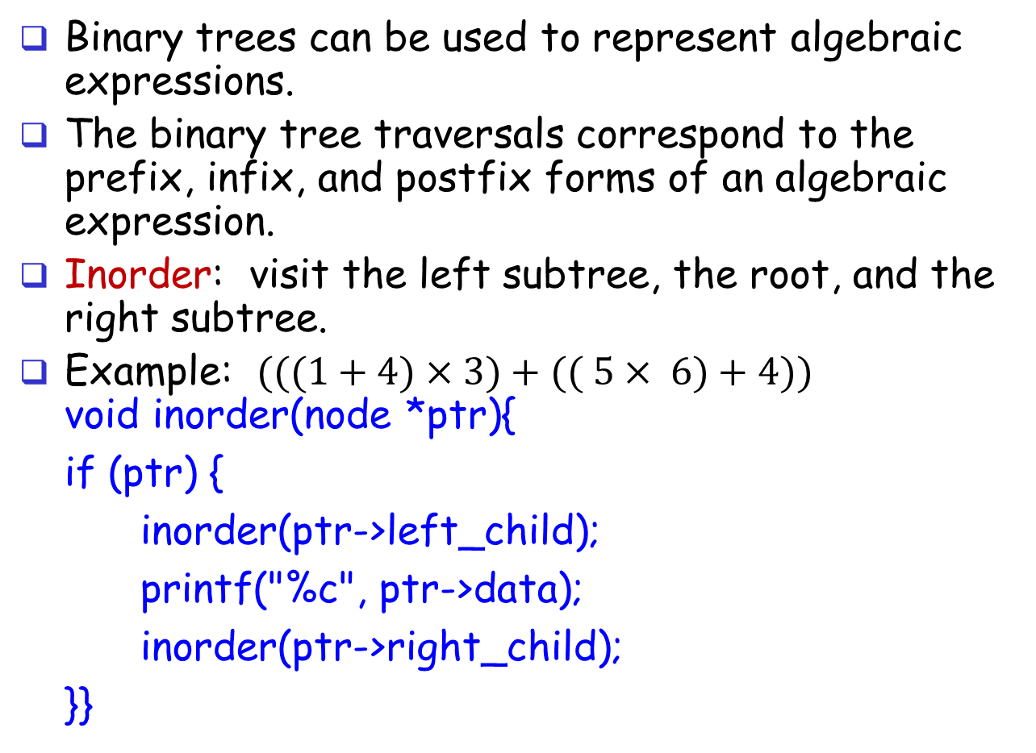
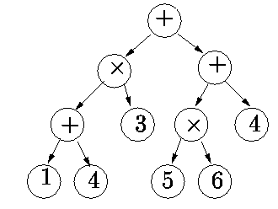
Binary Tree Traversals
Binary trees can be used to represent algebraic expressions.
The binary tree traversals correspond to the prefix, infix, and postfix forms of an algebraic expression.
Inorder: visit the left subtree, the root, and the right subtree.
Example: $(((1+4)×3)+(( 5× 6)+4))$ void inorder(node *ptr){
if (ptr) {
inorder(ptr->left_child);
printf("%c", ptr->data);
inorder(ptr->right_child);
}}

Slide 20
Binary Tree Traversals
Inorder: visit the left subtree, the root, and the right subtree. void inorder(node *ptr){
if (ptr) {
inorder(ptr->left_child);
printf("%c", ptr->data);
inorder(ptr->right_child);
}}
ptr
void inorder(node *ptr){
if (ptr) {
inorder(ptr->left_child);
printf("%c", ptr->data);
inorder(ptr->right_child);
}}
void inorder(node *ptr){
if (ptr) {
inorder(ptr->left_child);
printf("%c", ptr->data);
inorder(ptr->right_child);
}}

Slide 21
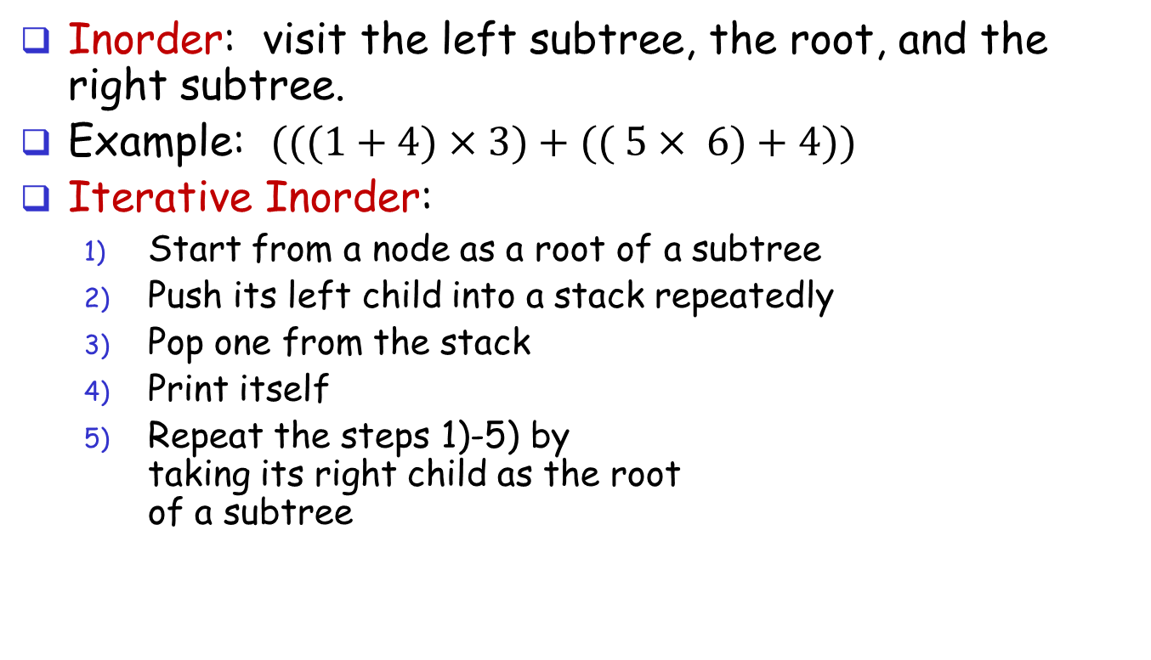
Binary Tree Traversals
Inorder: visit the left subtree, the root, and the right subtree.
Example: $(((1+4)×3)+(( 5× 6)+4))$
Iterative Inorder:
Start from a node as a root of a subtree
Push its left child into a stack repeatedly
Pop one from the stack
Print itself
Repeat the steps 1)-5) by taking its right child as the root of a subtree

Slide 22
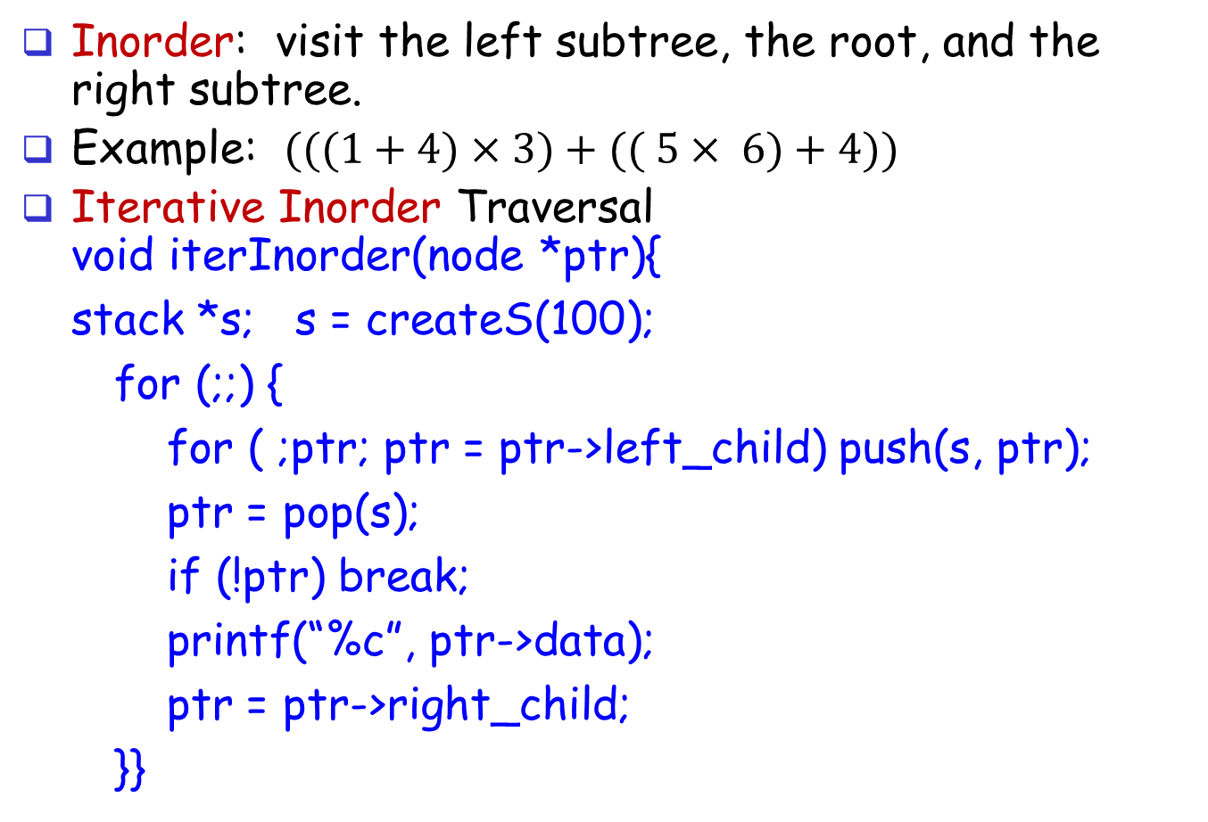
Binary Tree Traversals
Inorder: visit the left subtree, the root, and the right subtree.
Example: $(((1+4)×3)+(( 5× 6)+4))$
Iterative Inorder Traversal void iterInorder(node *ptr){
stack *s; s = createS(100);
for (;;) {
for ( ;ptr; ptr = ptr->left_child) push(s, ptr);
ptr = pop(s);
if (!ptr) break;
printf(“%c”, ptr->data);
ptr = ptr->right_child;
}}

Slide 23
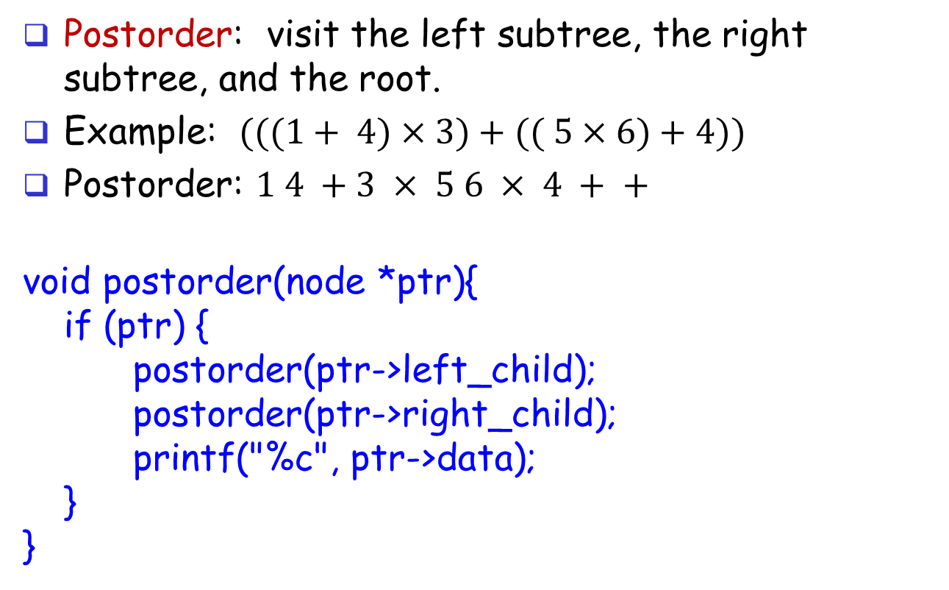
Binary Tree Traversals (cont'd)
Postorder: visit the left subtree, the right subtree, and the root.
Example: $(((1+ 4)×3)+(( 5×6)+4))$
Postorder: $1 4 +3 × 5 6 × 4 + +$
void postorder(node *ptr){
if (ptr) {
postorder(ptr->left_child);
postorder(ptr->right_child);
printf("%c", ptr->data);
}
}

Slide 24
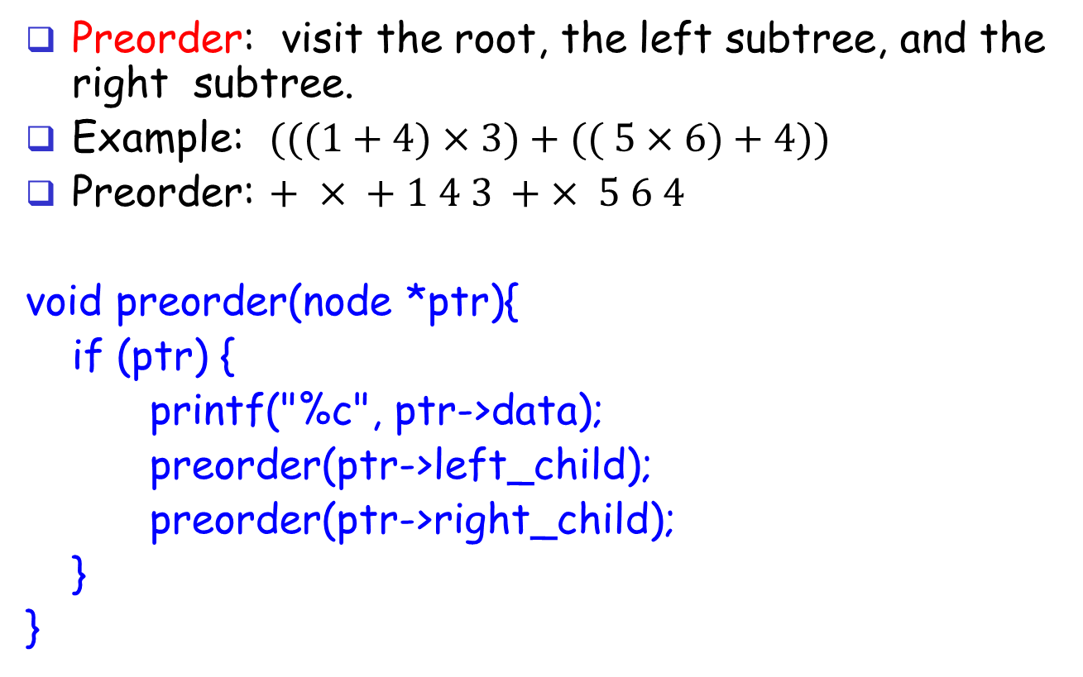
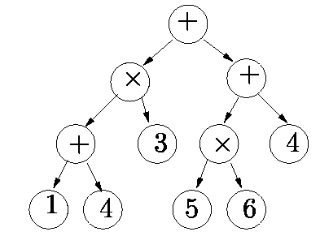
Binary Tree Traversals (cont'd)
Preorder: visit the root, the left subtree, and the right subtree.
Example: $(((1+4)×3)+(( 5×6)+4))$
Preorder: $+ × + 1 4 3 + × 5 6 4$
void preorder(node *ptr){
if (ptr) {
printf("%c", ptr->data);
preorder(ptr->left_child);
preorder(ptr->right_child);
}
}

Slide 25
Exercises
Time complexity
For a binary tree with n nodes, what is the time complexity of Inorder/Postorder/Preorder traversal?
Implementation
Iterative Postorder
void iterPostorder(node *ptr);
Iterative Preorder
void iterPreorder(node *ptr);

Slide 26
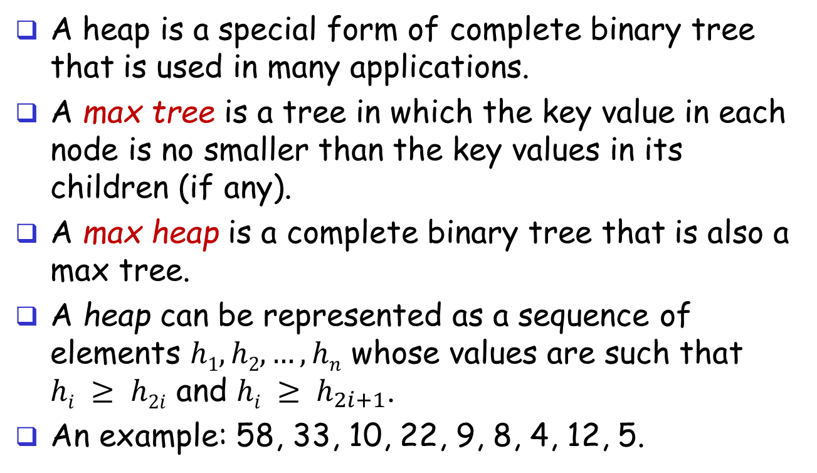
Max Heap
A heap is a special form of complete binary tree that is used in many applications.
A max tree is a tree in which the key value in each node is no smaller than the key values in its children (if any).
A max heap is a complete binary tree that is also a max tree.
A heap can be represented as a sequence of elements $h1, h2, …, hn$ whose values are such that $hi ≥ h2i$ and $hi ≥ h_{2i+1}$.
An example: 58, 33, 10, 22, 9, 8, 4, 12, 5.

Slide 27
Heap ADT
Objects: a complete binary tree of n>0 elements organized so that the value in each node is at least as large as those in its children.
Functions:
Heap Create(max_size): create an empty heap that can hold a max of max_size elements
Boolean HeapFull(heap, n): if (n==max_size) return TRUE else return FALSE
InsertHeap(heap,item,n): if (!HeapFull(heap,n)) insert item into heap
Boolean HeapEmpty(heap,n): if (n==0) return TRUE else FALSE
Element DeleteHeap(heap,n): if (!HeapEmpty(heap,n)) return one instance of the largest element in the heap and remove it from the heap

Slide 28
Heap Insertion (to insert 5)
[1]
20
[1]
20
[2]
15
[3]
2
[2]
15
[3]
2
[4]
14
[5]
10
[4]
14
[5]
10
[6]
initial heap
add the new node
[1]
20
[1]
20
[2]
15
[3]
[2]
15
[3]
5
2
[4]
[5]
[6]
[4]
14
[5]
10
[6]
2
14
10
insert 5
after inserting 5

Slide 29
Heap Insertion (to insert 21)
[1]
20
[1]
20
[2]
15
[3]
2
[2]
15
[3]
2
[4]
14
[5]
10
[4]
14
[5]
10
[6]
initial heap
add the new node
[1]
20
[1]
21
[2]
15
[3]
[2]
15
[3]
20
2
[4]
[5]
[6]
[4]
14
[5]
10
[6]
2
14
10
insert 21
after inserting 21

Slide 30
Insert Heap Function
void InsertHeap(Heap heap, element item, int *n)
/* insert item into a heap of current size *n */
{ int i;
if (HeapFull(heap,*n)) {
printf(“The heap is full.\n”);
return;
}
i = ++(*n);
while ((i != 1) && (item.key > heap[i/2].key)) {
heap[i] = heap[i/2]; /* move down */
i = i / 2; /* shift index to parent node */
}
heap[i] = item;
}

Slide 31
Deletion from Heap
[1]
20
[1]
[2]
15
[3]
2
[2]
15
[3]
2
[4]
14
[5]
10
[4]
14
[5]
10
initial heap
delete h[1]: the largest
[1]
10
[1]
15
[2]
15
[3]
[2]
14
[3]
2
2
[4]
[4]
10
14
place h[n] at the root
final heap

Slide 32
Deletion from Heap (Another example)
[1]
20
[1]
[2]
15
[3]
18
[2]
15
[3]
18
[4]
14
[5]
10
[4]
14
[5]
10
initial heap
delete h[1]: the largest
[1]
10
[1]
18
[2]
15
[3]
[2]
15
[3]
10
18
[4]
[4]
14
14
place h[n] at the root
final heap

Slide 33
Delete Heap Function
element DeleteHeap(Heap heap, int *n) /*delete item with the highest */
{ int parent, child;
element item, temp; item = heap[1];
/* use last element in heap to adjust heap */
temp = heap[(*n)--];
parent = 1; child = 2; /* start from the root */
while (child <= *n) { /* find the larger child of the current parent */
if (child < *n) && (heap[child].key < heap[child+1].key)
child++; /* shift from left child to the right child */
if (temp.key >= heap[child].key) break;
/* move key up and go to the next lower level */
heap[parent]=heap[child]; parent=child; child = child * 2;
}
heap[parent]= temp;
return item;
}

Slide 34
Arrays: Same or Different?
Consider the three arrays: top, mid, and bottom. Are they the same?
Which one is sorted, which one is in random order, and which one is neither sorted nor random?
58 | 33 | 22 | 12 | 10 | 9 | 8 | 5 | 4
58 | 33 | 10 | 12 | 9 | 8 | 4 | 22 | 5
58 | 33 | 10 | 22 | 9 | 8 | 4 | 12 | 5

Slide 35
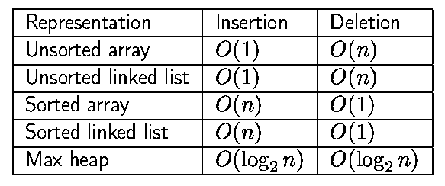
Priority Queue (1)
A special kind of queue: Each element in the priority queue has a priority.
A priority queue dequeues (deletion) the element with the highest priority.
Consider the operations: enqueue() for insertion, dequeue() for deletion.
We need to get the one with max value? But, how?
Sort all in order, or use random order, or do something else?
58 | 33 | 10 | 12 | 9 | 8 | 4 | 22 | 5
58 | 33 | 22 | 12 | 10 | 9 | 8 | 5 | 4
58 | 33 | 10 | 22 | 9 | 8 | 4 | 12 | 5

Slide 36
Priority Queue (2)
If we maintain the total order among all, we need to sort all elements before we want to find the max value.
Are they the same? Sort from the beginning or sort when a new element is inserted into an already sorted array.
If we maintain the random order, we need to check all elements to find the max value when we want to find the max value.
58 | 33 | 10 | 12 | 9 | 8 | 4 | 22 | 5
58 | 33 | 22 | 12 | 10 | 9 | 8 | 5 | 4
58 | 33 | 10 | 22 | 9 | 8 | 4 | 12 | 5

Slide 37
Priority Queue (3)
If we maintain the total order among all, we need to sort all elements before we want to find the max value.
If we maintain the random order, we need to check all elements to find the max value when we want to find the max value.
We use the max heap!
Refer to the algorithms on how to do “insert heap” and “delete heap”.
We manipulate a max heap to implement a priority queue.
58 | 33 | 10 | 12 | 9 | 8 | 4 | 22 | 5
58 | 33 | 22 | 12 | 10 | 9 | 8 | 5 | 4
58 | 33 | 10 | 22 | 9 | 8 | 4 | 12 | 5

